Slide 1


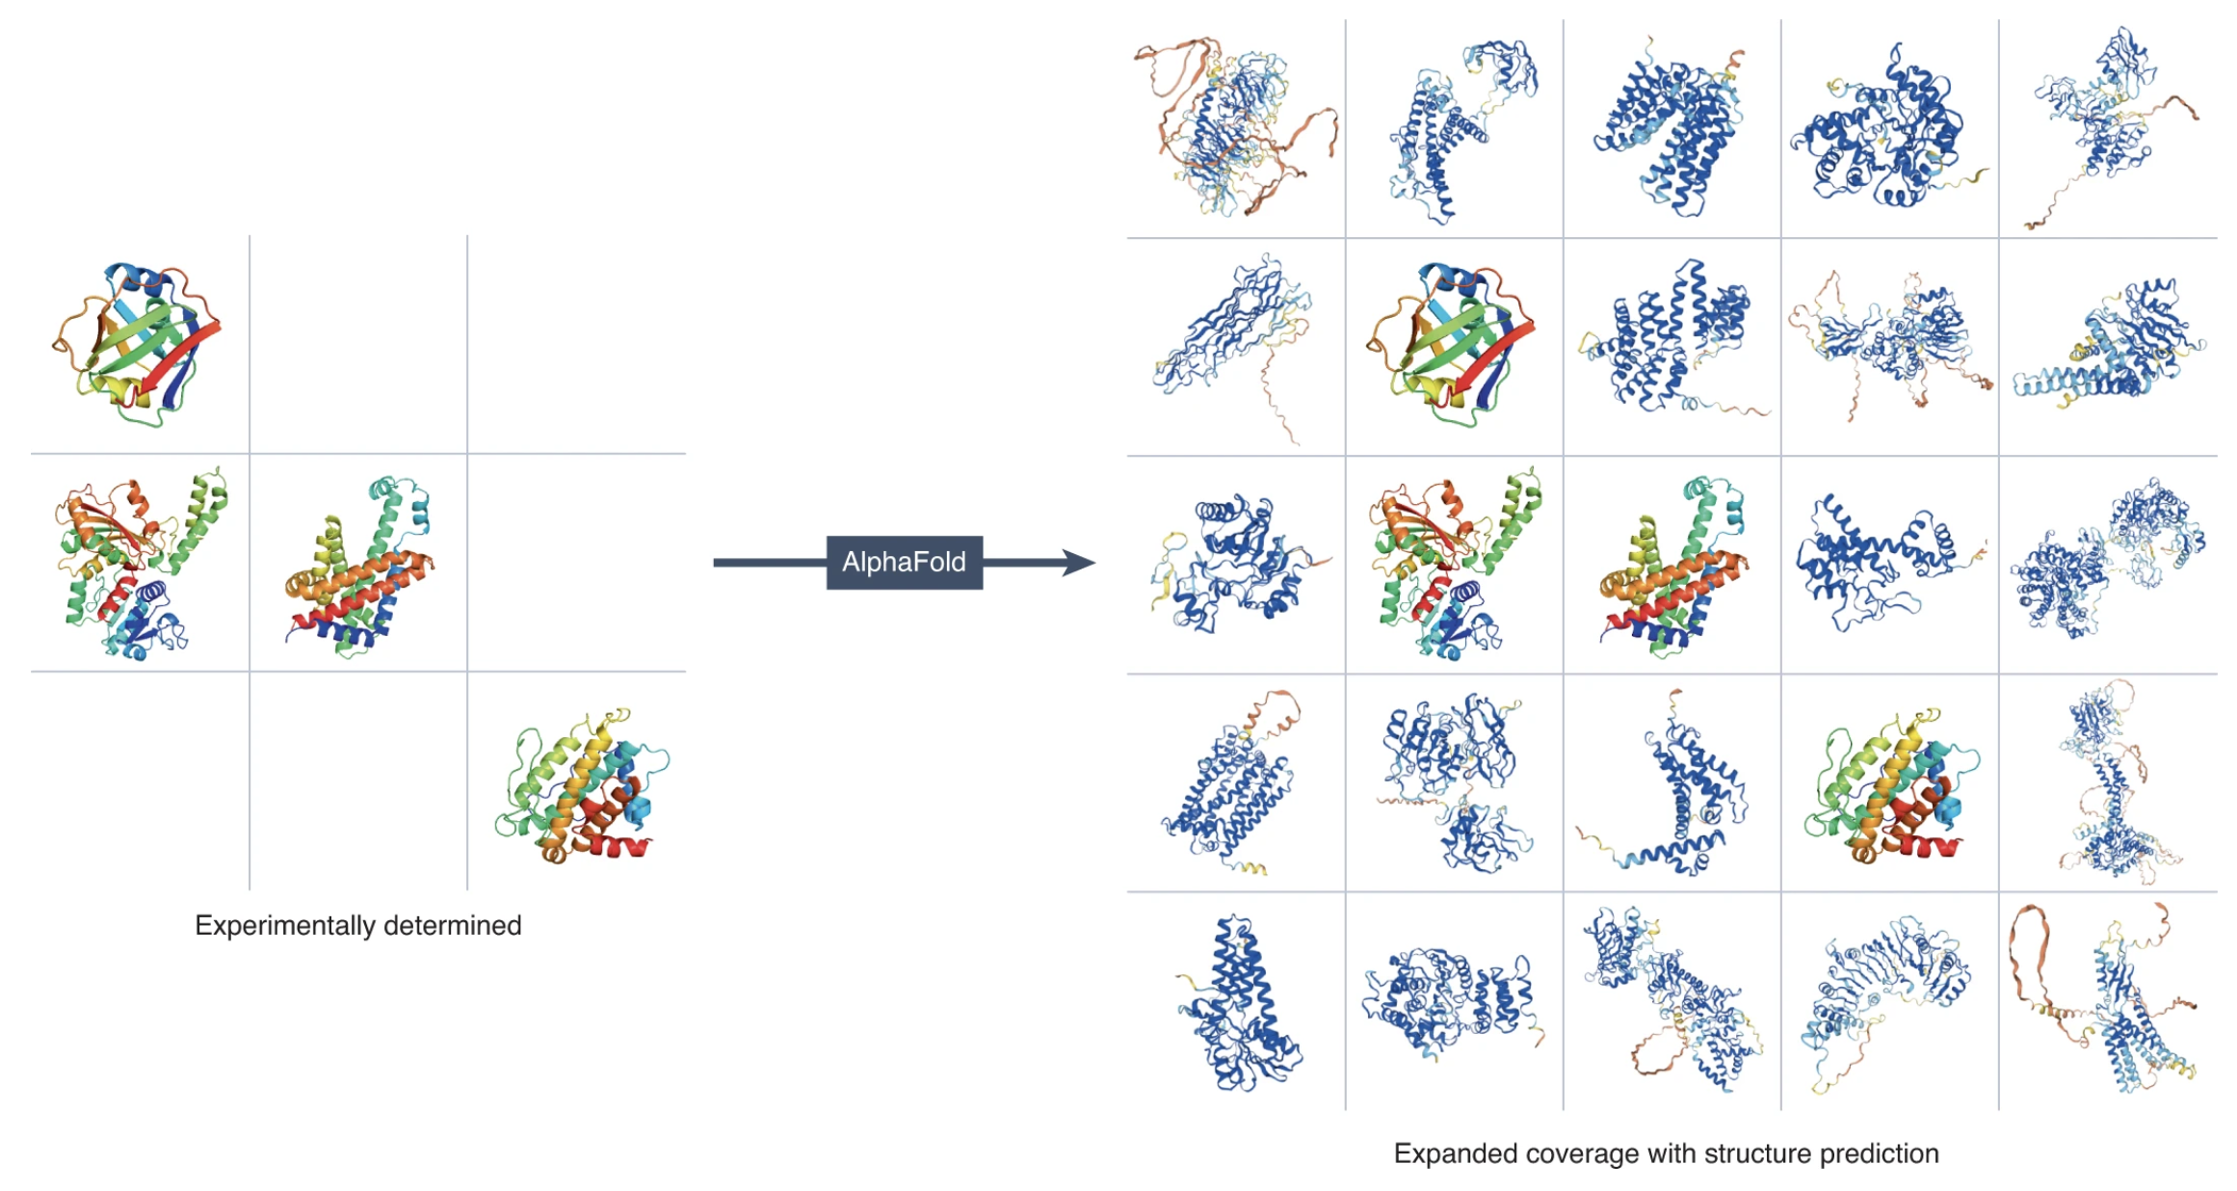
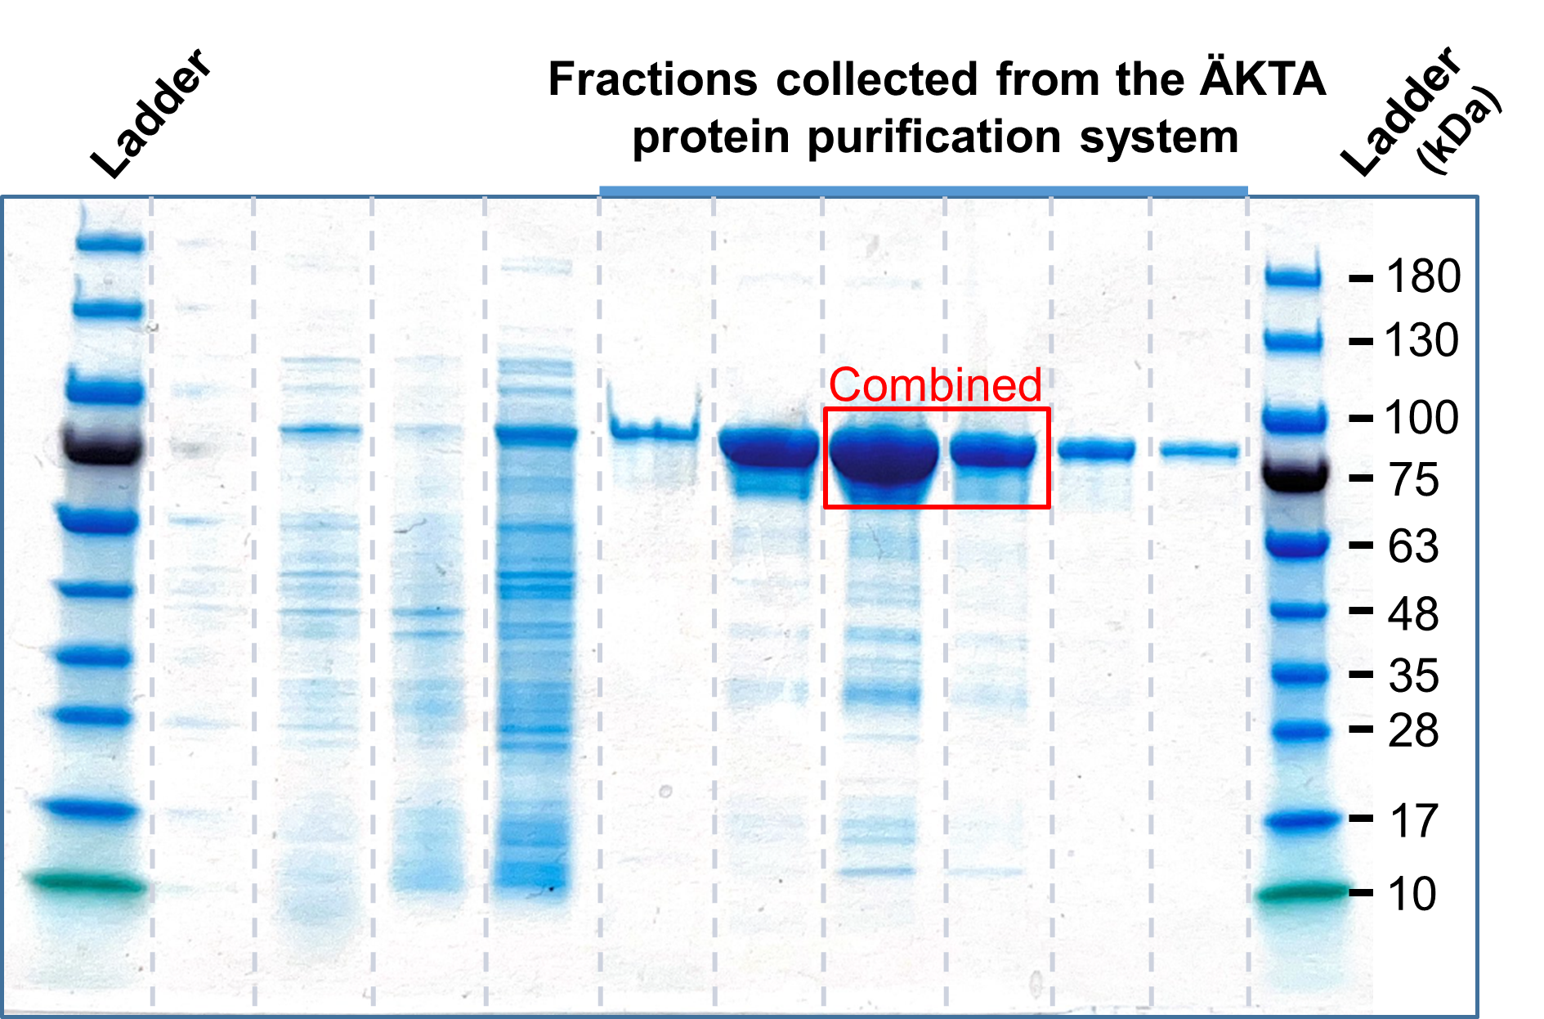
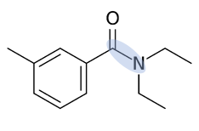
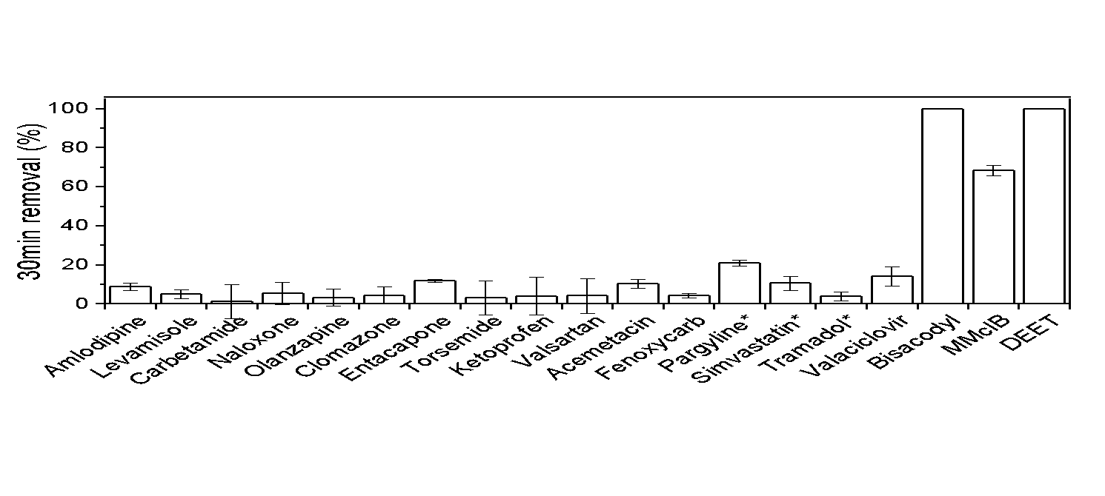
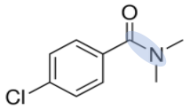
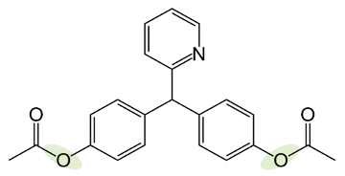




Graphical abstract
Active
Stream biofilm metagenomes
Hydrolase activity screening
Sequence-structure-active site analysis
Inactive
AlphaFold
Test
Purify active hydrolases
>MPEKPNIVYFHVDNLGMGELG…
>MSKRPNFLVIVADDLGFSDIG…
>MPTKPNILVIWGDDIGIWNIS…
>MANAADTPSTATARKGFAGYD…
>MLKNVPFKRTMLASMLTLASG…
Test activity with >180 organic contaminants
Figure: Jumper J. (2022) Nature Methods to be replaced
Carboxylic ester bond
Amide bond
Notes:
N, N-diethyl-m-toluamide (DEET, diethyltoluamide) is one of the most detected trace organic contaminants (TOrC) in environmental water samples (Anumol et al., 2013; Bussan et al., 2017; Kolpin et al., 2002; Loraine and Pettigrove, 2006). DEET is primarily used an insect repellent and was developed by the US army in 1946 and made available to the general public in 1957 (Kitchen et al., 2009). Currently, DEET as the active ingredient for insect repellents can be found in many different formulations such as spray, liquid and lotion in concentrations as high as 100% or incorporated into consumer products like clothes (Pennetier et al., 2010). In 1998 the United States Environmental Protection Agency (US EPA) estimated the annual usage of DEET to be 1810 tons (Chen et al., 2012), and in 2013 there were 422 registration numbers held by 235 companies for 524 commercial names of DEET-containing products (Merel and Snyder, 2016).

